Slide 1

The View Transformation
CS 418: Interactive Computer Graphics
UNIVERSITY OF ILLINOIS AT URBANA-CHAMPAIGN
Eric Shaffer

Slide 2
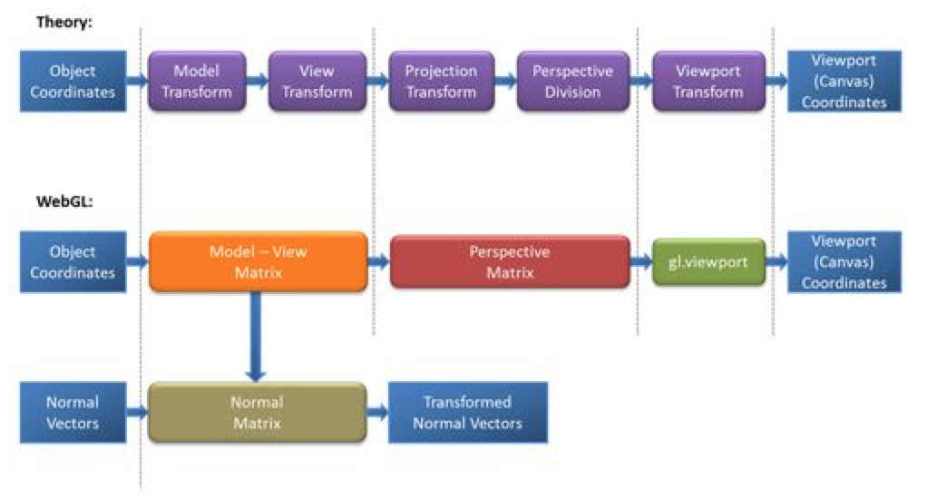
Graphics Pipeline and WebGL
From WebGL Beginner’s Guide by Cantor and Jones

Slide 3
Which of the following mean the same thing?
See if you can guess…
Camera transformation
Eye transformation
View transformation
Camera space
Eye space
Clip space
Normalized device coordinates
Viewport transformation
Windowing transformation
Screen space
Pixel coordinates
Viewport coordinates

Slide 4
Computer Graphics has Non-standardized Vocabulary
Camera transformation
Eye transformation
View transformation
Camera space
Eye space
Clip space
Normalized device coordinates
Viewport transformation
Windowing transformation
Screen space
Pixel coordinates
Viewport coordinates
So don’t be afraid to ask someone what something means

Slide 5
Viewing
We often will want to allow the view of our 3D scene to change
We can do so using by applying affine transformations to the geometry
A view matrix is functionally equivalent to a camera It is a transformation matrix like the Model matrix, but
Happens after the modeling transformation
It applies the same transformations equally to every object
Moving the whole world 5 units towards us = walking 5 units forwards
The engines don’t move the ship at all. The ship stays where it is and the engines move the universe around it.
-- Futurama

Slide 6
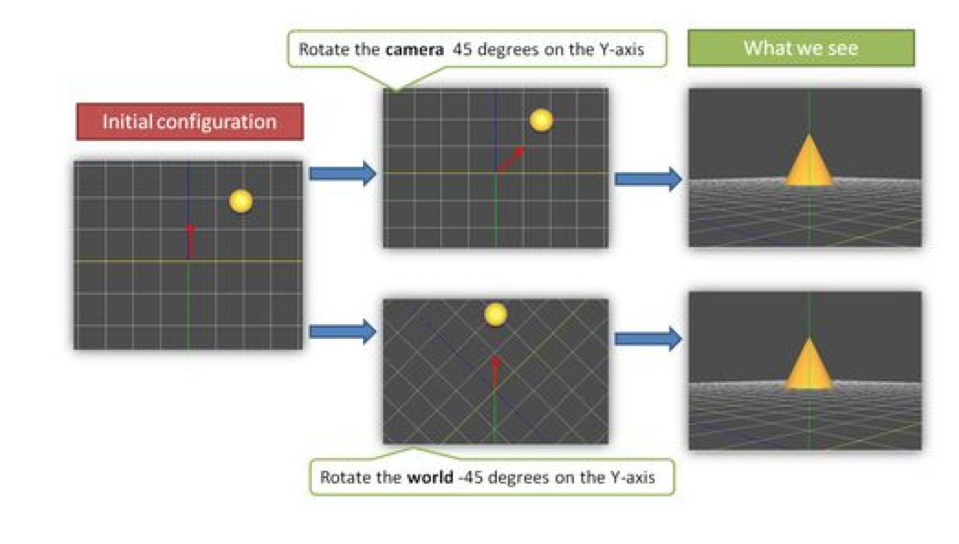
Example
From WebGL Beginner’s Guide by Cantor and Jones

Slide 7
Graphics Pipeline
Model Coords
Model Xform
World Coords
Viewing Xform
Viewing Coords
Perspective Distortion
Homogeneous Divide
Still Clip Coords.
Clipping
Clip Coords.
Window
Coordinates
Window
to
Viewport
Viewport
Coordinates

Slide 8
Graphics Pipeline
Model Coords
Model Xform
World Coords
Viewing Xform
Viewing Coords
Perspective Distortion
Homogeneous Divide
Still Clip Coords.
Clipping
Clip Coords.
Window
Coordinates
Window
to
Viewport
Viewport
Coordinates
M

Slide 9
Viewing Transformation
Model Coords
Model Xform
World Coords
Viewing Xform
Viewing Coords
Perspective Distortion
Homogeneous Divide
Still Clip Coords.
Clipping
Clip Coords.
Window
Coordinates
Window
to
Viewport
Viewport
Coordinates

Slide 10
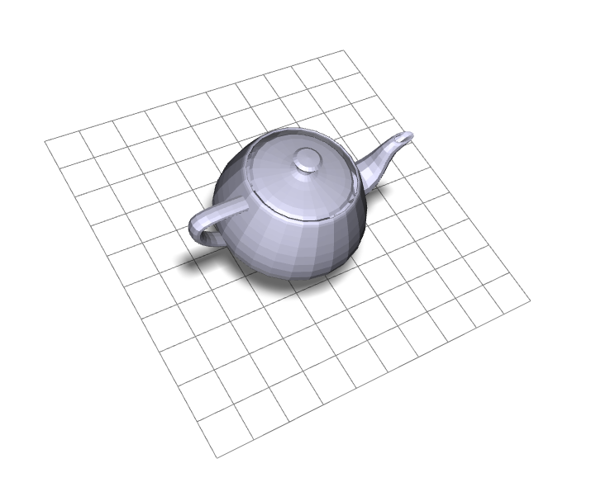
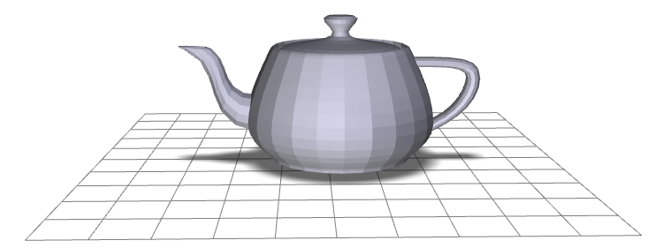
Viewing Transformation
eye point
lookat point
y
y
x
x
z
Screen Coords
Clip Coords
Viewing Coords
World Coords
Model Coords

Slide 11
Creating a Camera Function
Suppose we want to implement a function that sets up view …think of it as setting up a camera
There are lots of possible ways to do this…we’ll choose a simple lookat camera
The API we create will require a someone using the function to specify:
The eyepoint (or camera location)
The lookat point (a point in the view direction)
An ”up” vector that we use to specify rotation around the view vector

Slide 12
Deriving the Viewing Transformation
One way to think about what you are doing
Translate the eyepoint to the origin
Rotate so that
lookat vector aligns with –z axis
up aligns with y
We move all objects (the world) this way…
Another way to think of it
Create an orthonormal basis with eye at the origin
And vectors u, v, w as the basis vectors
…and then align u,v,w with x,y,z

Slide 13
Constructing a Local Frame
A frame has an origin point and set of basis vectors
Any point can be expressed as coordinates in such a frame
For example (0,0,0) and <1,0,0>, <0,1,0>,<0,0,1>
And an example of a point in that space: (4,0,0)= (0,0,0) + 4 <1,0,0> + 0 <0,1,0> + 0 <0,0,1>

Slide 14
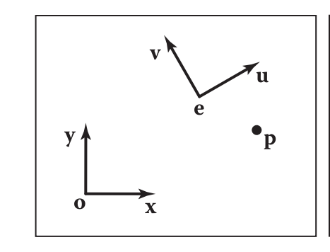
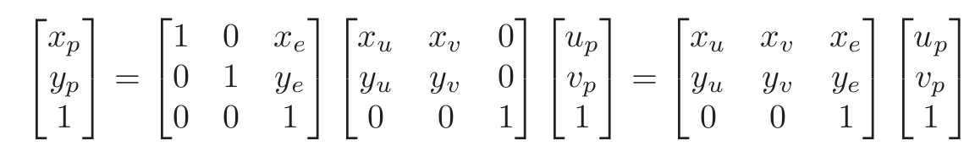
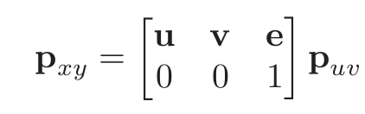
Example in 2D
How would we convert from (x,y) to (u,v)?
To convert coordinates from (u,v) space to (x,y) we can:
This can be written as

Slide 15
Example in 2D
Imagine we want to see the point p as it would be seen in (u,v) space
That means we convert the point to (u,v) coordinates…pretend those are the (x,y)
Alternatively, think of the matrix as rotating & translating p so it is seen as if in (u,v) space
To convert coordinates from (u,v) space to (x,y) we can:
This can be written as

Slide 16
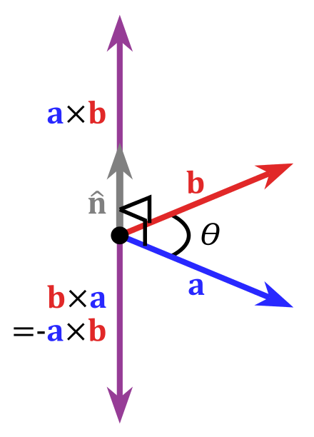
Cross Product of Two Vectors
Important Property: The cross product yields a vector orthogonal to the original two vectors

Slide 17
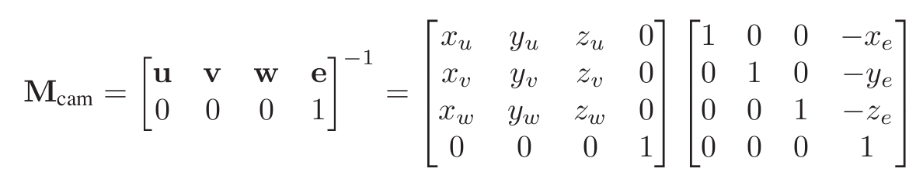
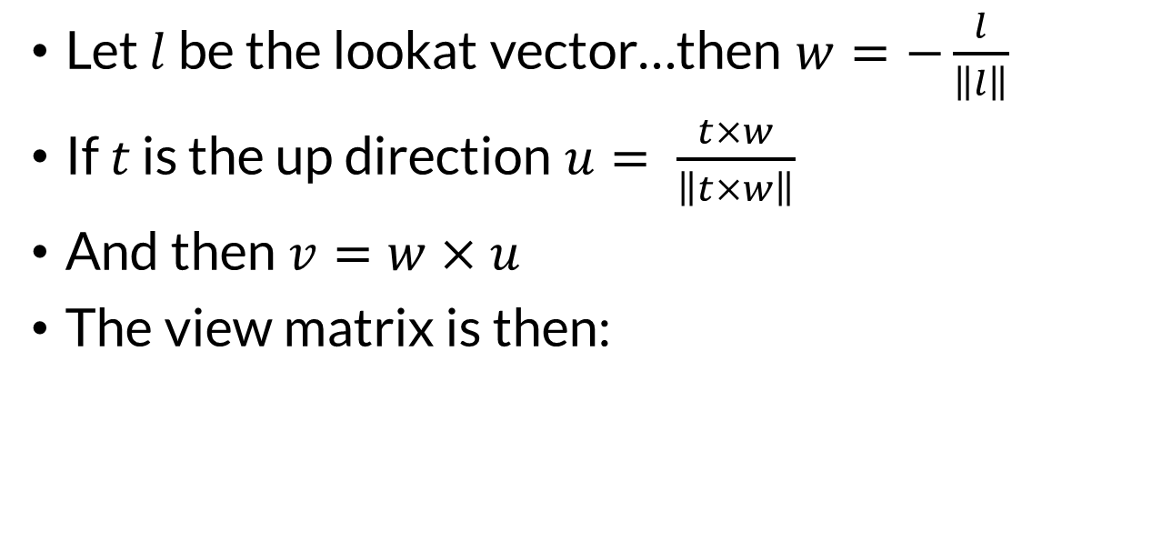
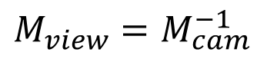
The Orthonormal Basis for View Space
Let $l$ be the lookat vector…then $w=−\frac{l}{\left\|l\right\|}$
If $t$ is the up direction $u= \frac{t×w}{\left\|t×w\right\|}$
And then $v=w×u$
The view matrix is then:
$${M_{view}=M}_{cam}^{−1}$$
Why is the matrix inverted?

Slide 18
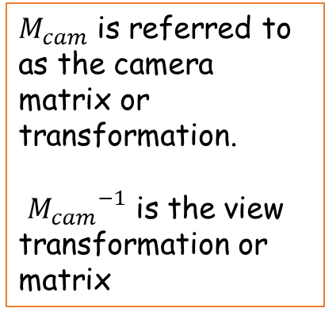
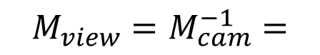
View Transformation
$M_{cam}$ is referred to as the camera matrix or transformation. ${M_{cam}}^{−1}$ is the view transformation or matrix
You can now look at your scene from any
Position
Orientation (almost)
What lookat and up vector pair won’t work?
…just uses a matrix multiplication
$${M_{view}=M}_{cam}^{−1}=$$

Slide 19
glMatrix lookAt transform
{mat4} mat4.lookAt(out, eye, center, up)
Generates a look-at matrix with the given eye position, focal point, and up axis
Parameters:
{mat4} out
mat4 matrix will be written into
{vec3} eye
Position of the viewer
{vec3} center
Point the viewer is looking at
{vec3} up
vec3 pointing up
Returns:
{mat4} out
glMatrix can compute a lookAt transformation for you
How would you implement a moving camera?
What key difficulties would you need to handle?

Slide 20
Let’s review viewing….
We start out by setting up our geometry in world coordinates
Which transformation does this?

Slide 21
The view transformation
We pick a specific viewing position and direction in worldspace

Slide 22
The view transformation
We transform the world so the view position is at the origin. The view direction is down the –z axis

Slide 23
The projection transformation
We pick a viewing volume. This is specified in viewing coordinates.

Slide 24
The projection transformation
Our view volume is transformed to fit in the WebGL view volume
The WebGL view volume is a box with clip planes at -1, +1
The z coordinates are negated to flip the z-axis

